Slide 1
Going Deeper with Convolutions

Slide 2

Reminds me of

Slide 3
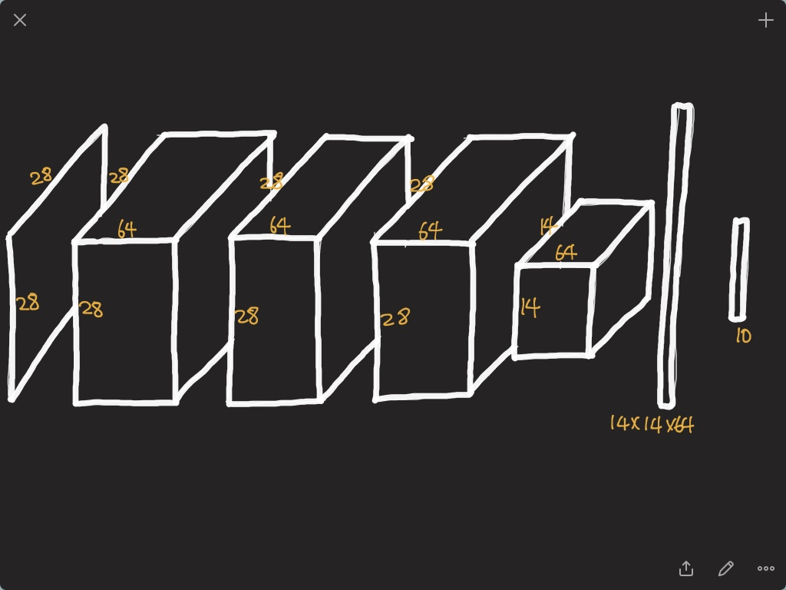

Slide 4
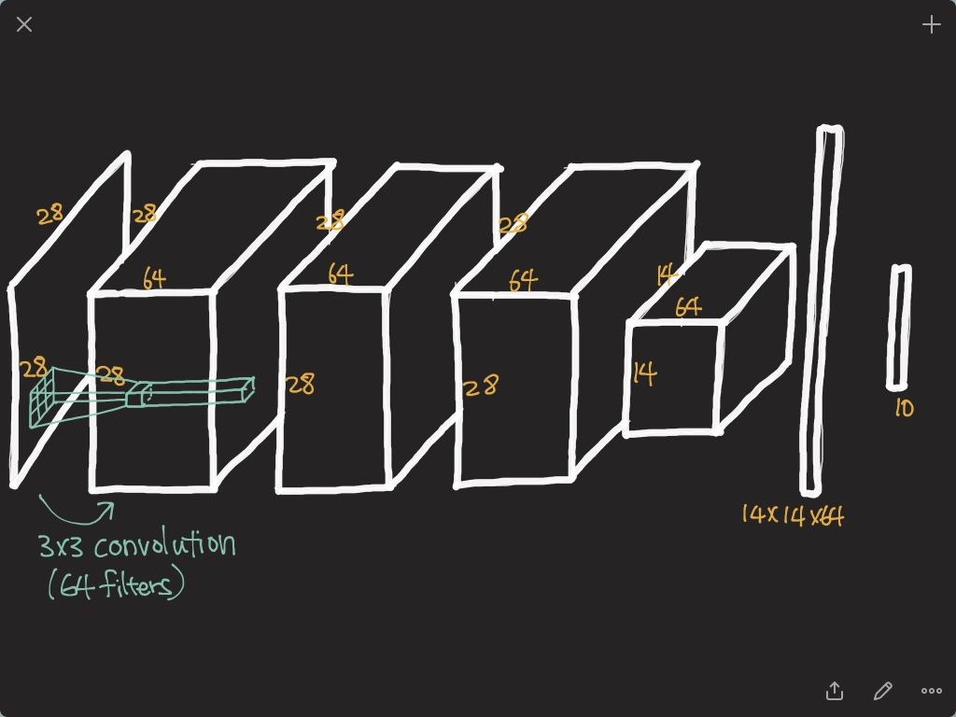

Slide 5
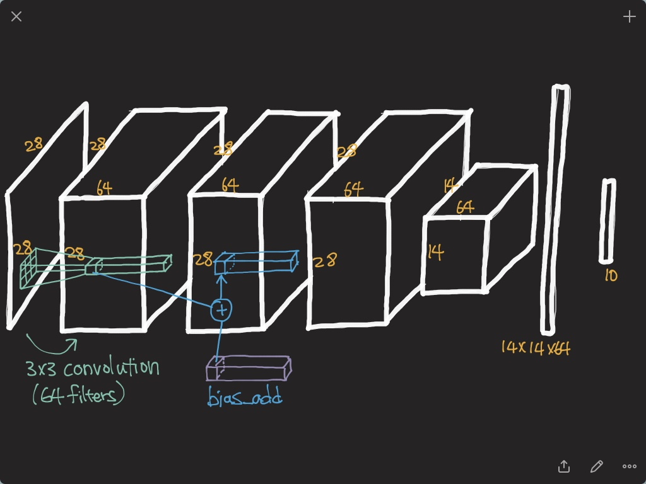

Slide 6
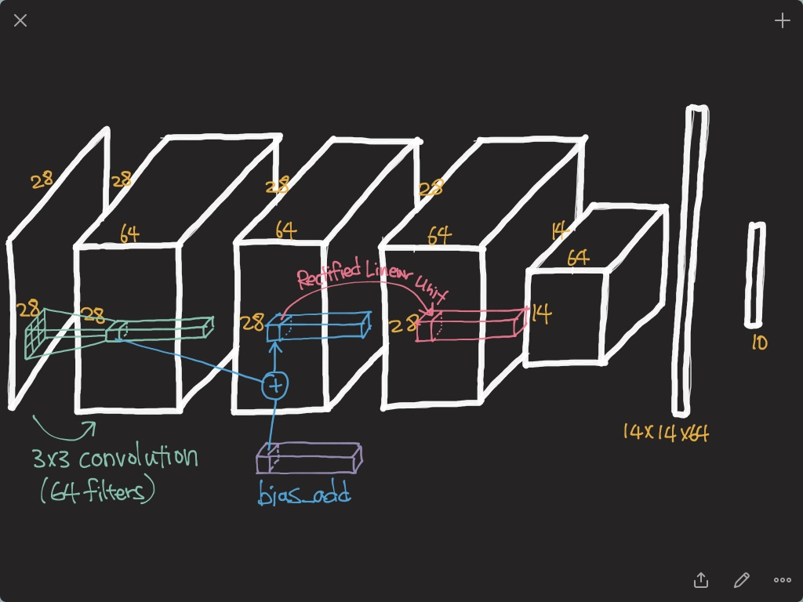

Slide 7
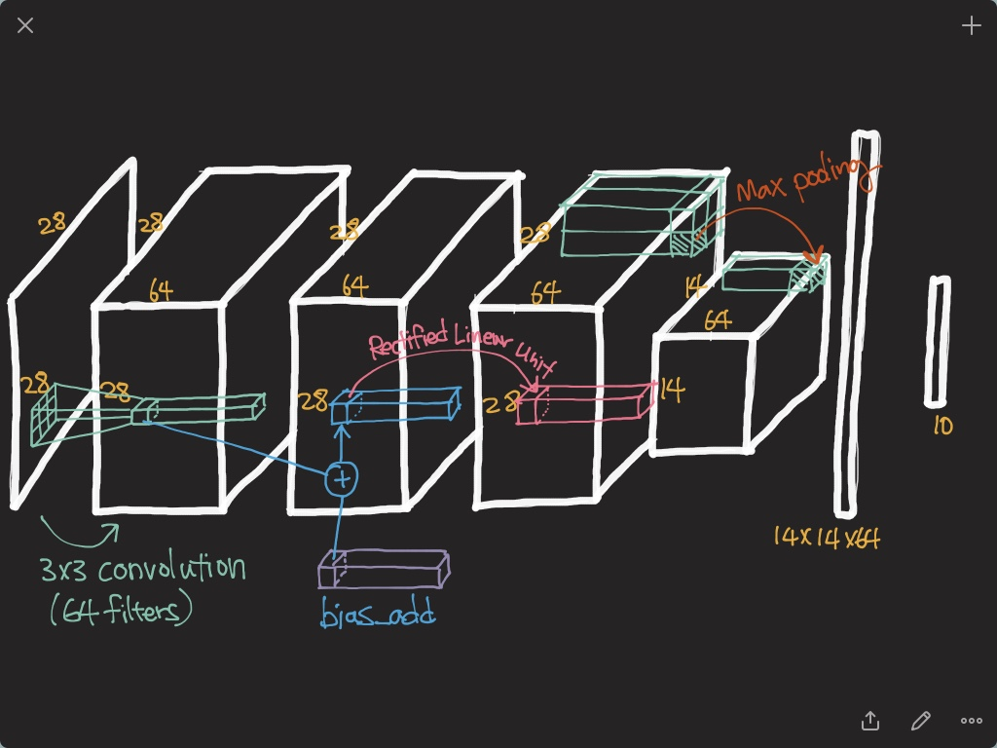

Slide 8
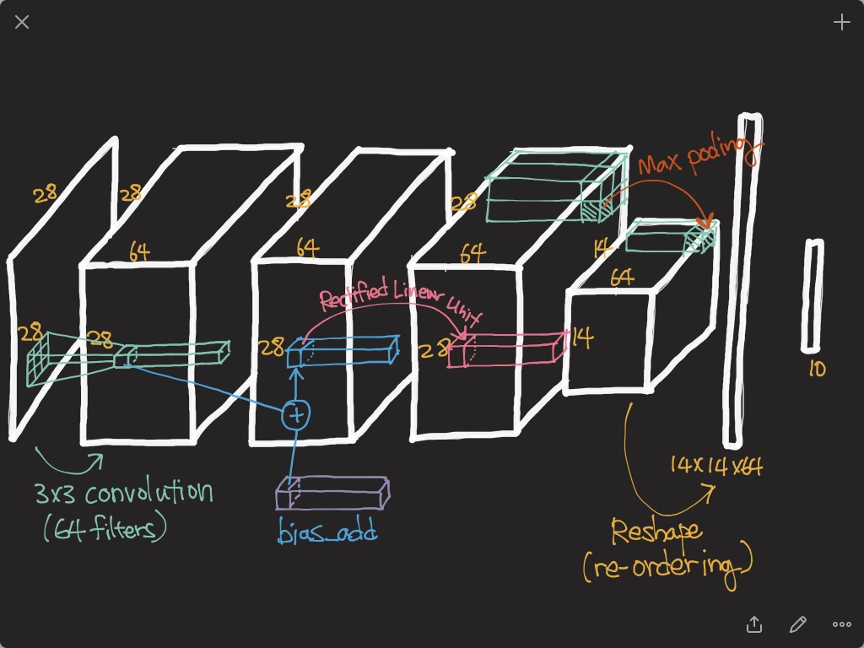

Slide 9
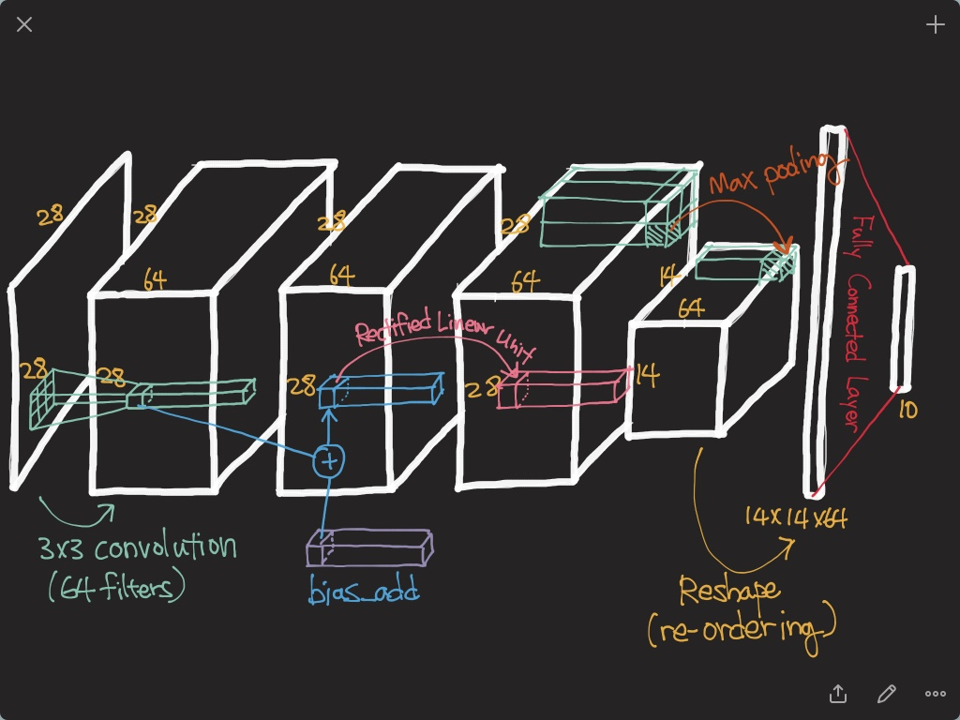

Slide 10
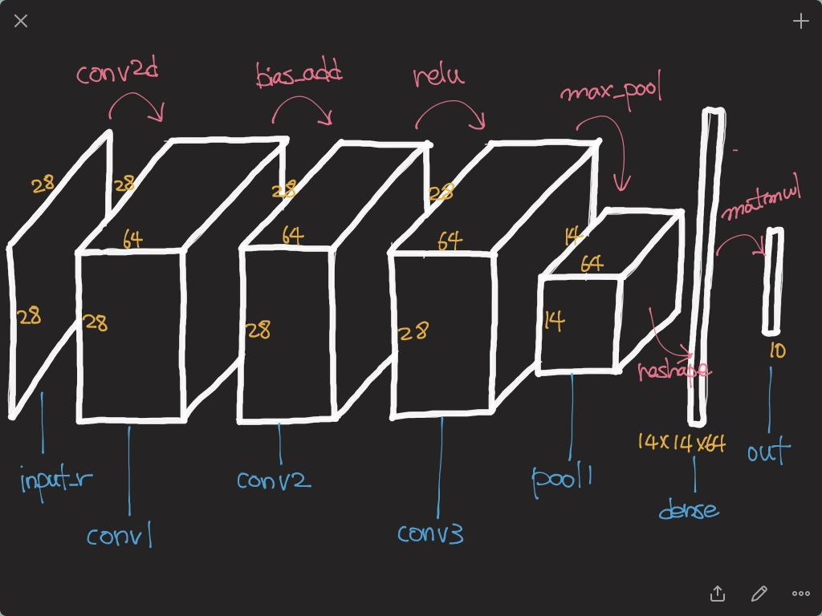

Slide 11
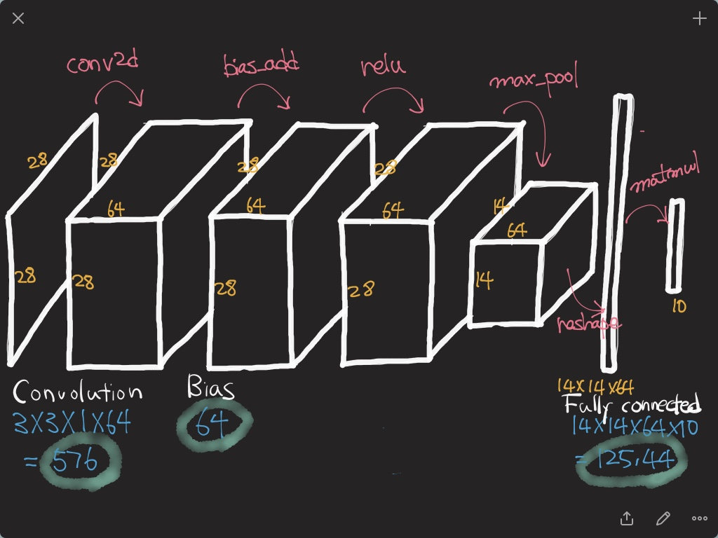

Slide 12


GoogLeNet

Slide 13
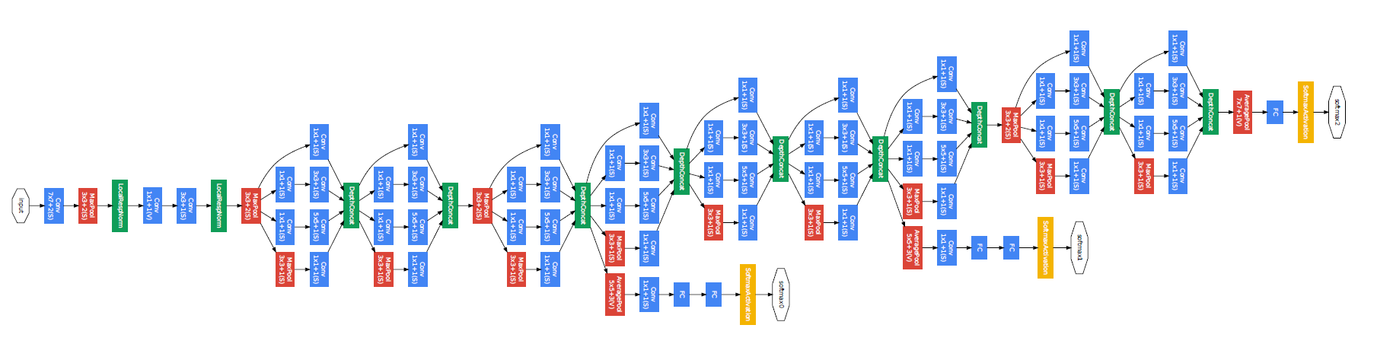
GoogLeNet
22 Layers Deep Network
Efficiently utilized computing resources, “Inception Module”
Significantly outperforms previous methods on ILSVRC 2014

Slide 14
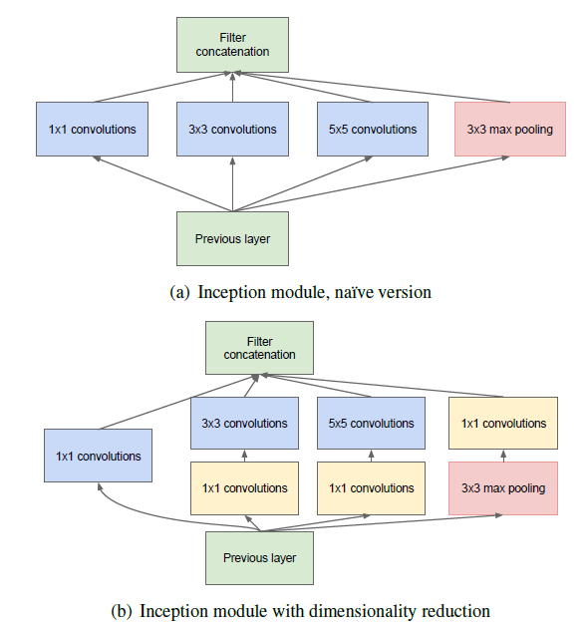
Inception module

Slide 15
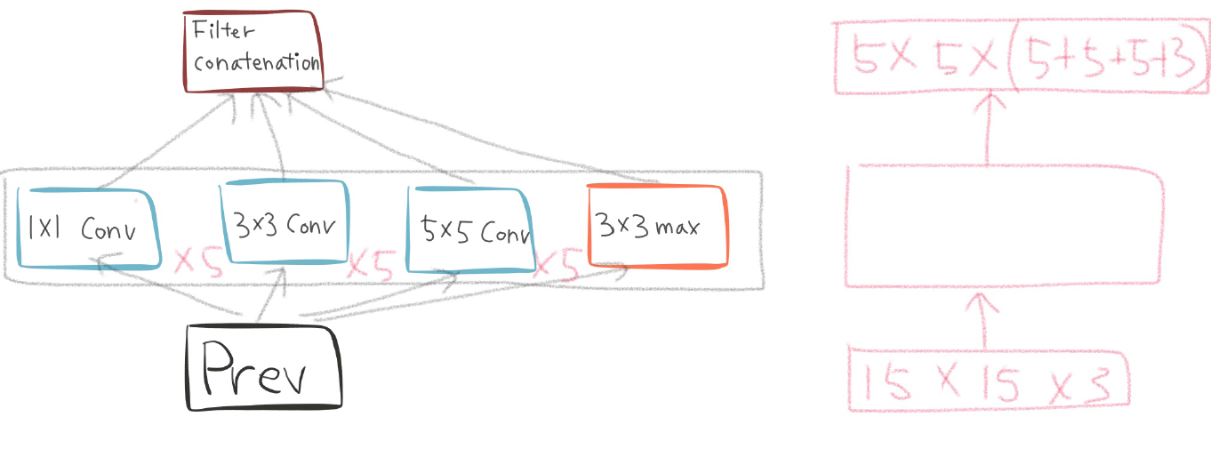
Naïve inception module

Slide 16
Naïve inception module

Slide 17
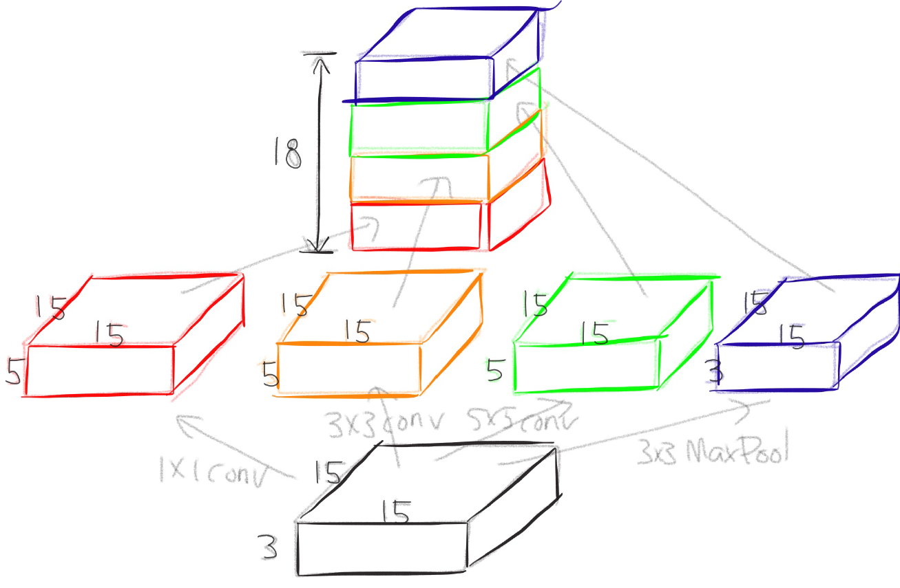
Naïve inception module

Slide 18
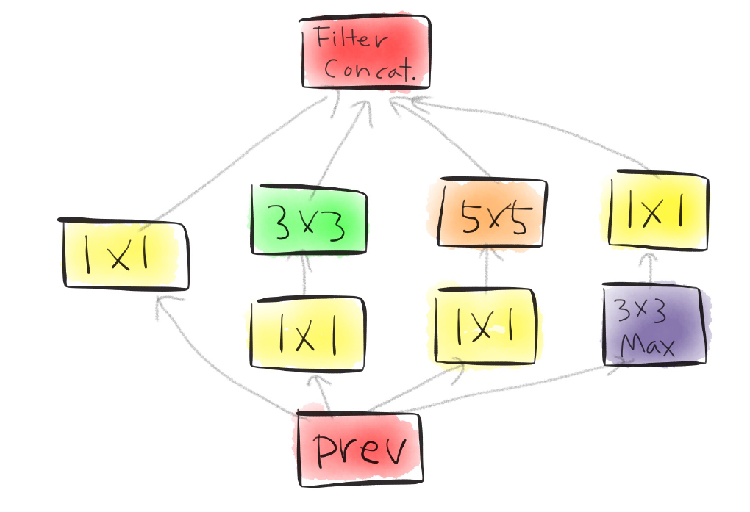
Actual inception module

Slide 19

One by one convolution

Slide 20
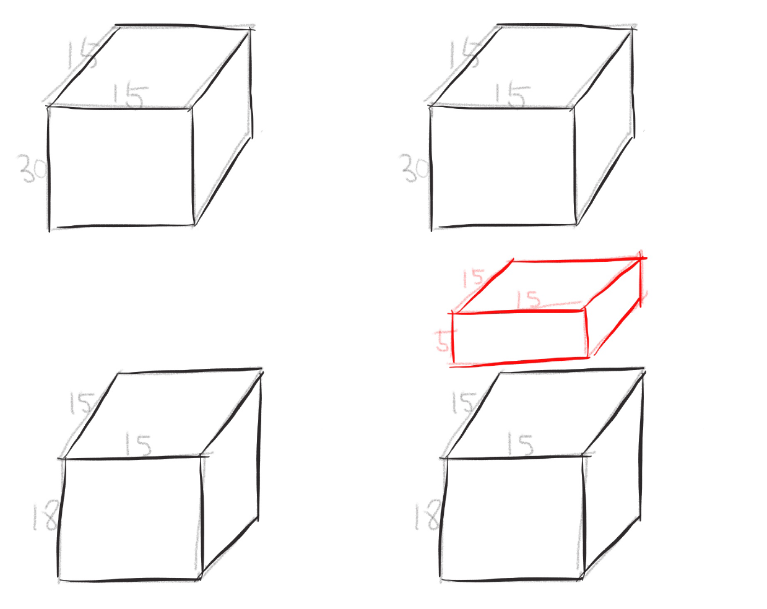
One by one convolution

Slide 21
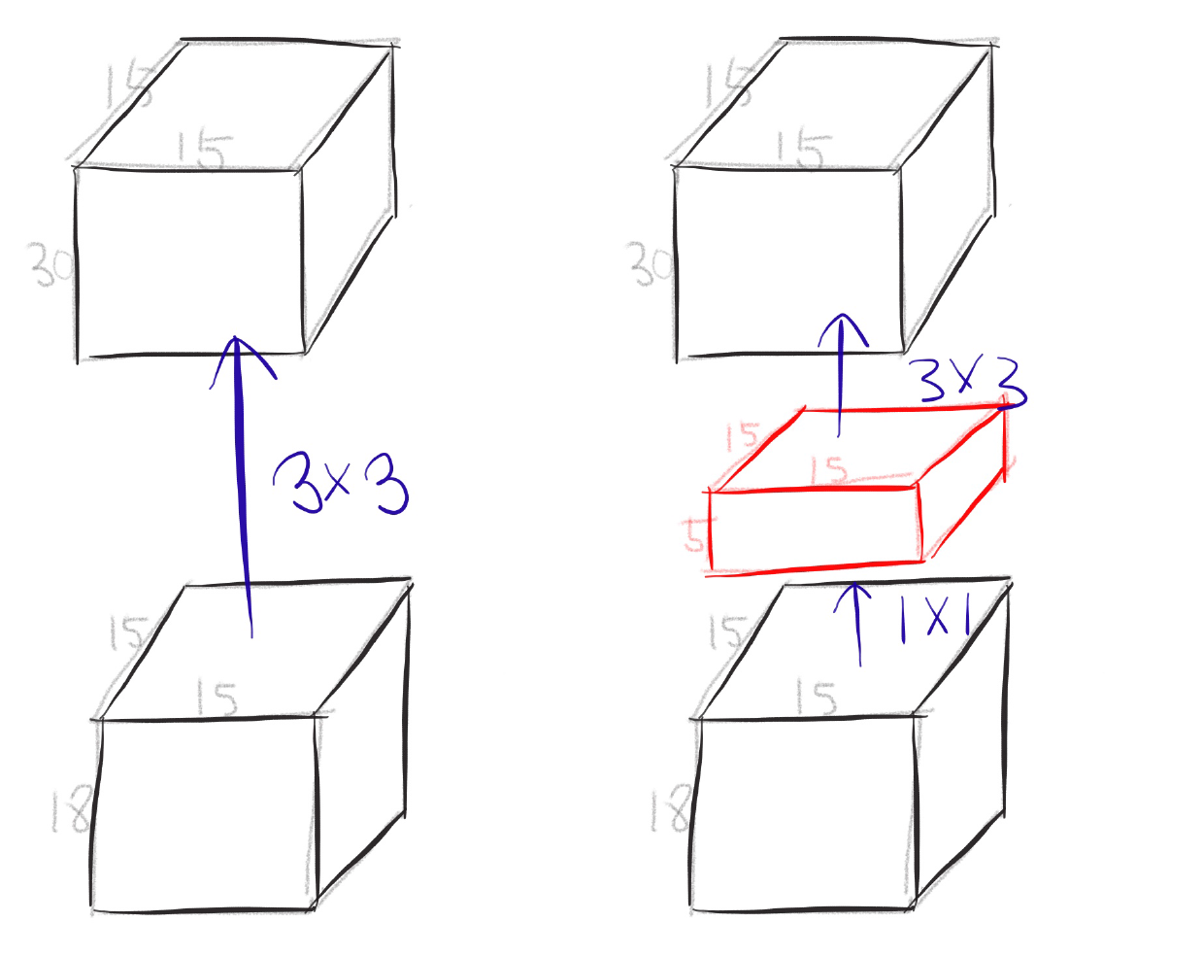
One by one convolution

Slide 22
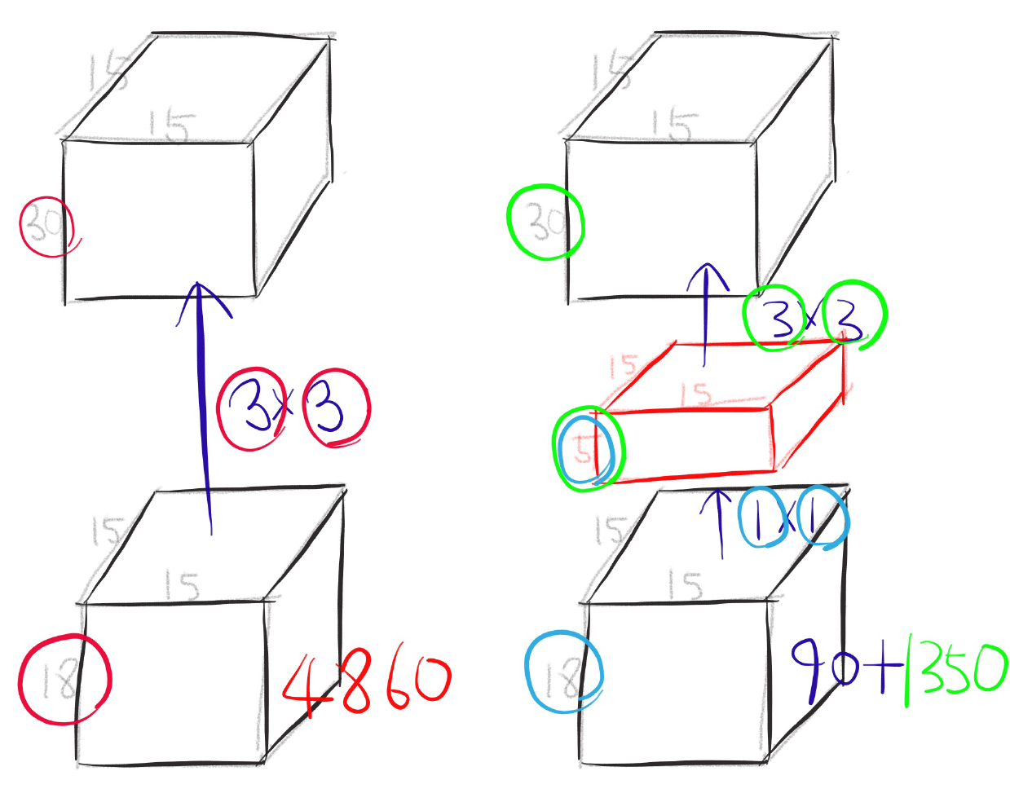
One by one convolution

Slide 23
GoogLeNet
Network in Network!

Slide 24

Conclusion
Very clever idea of using one by one convolution for dimension reduction!
Other than that...

Slide 25
Inception-v4, Inception-ResNet and the Impact of Residual Connections on Learning

Slide 26
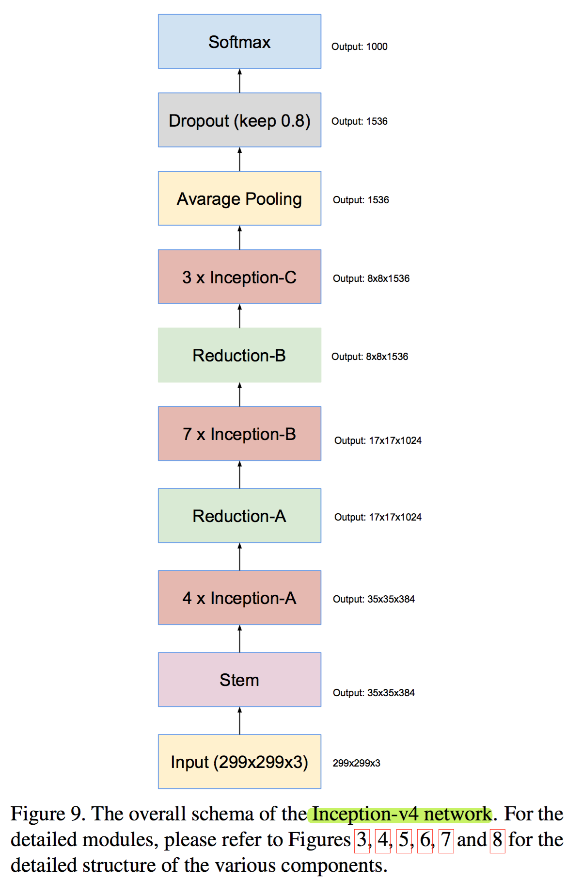
Residual inception blocks

Slide 27
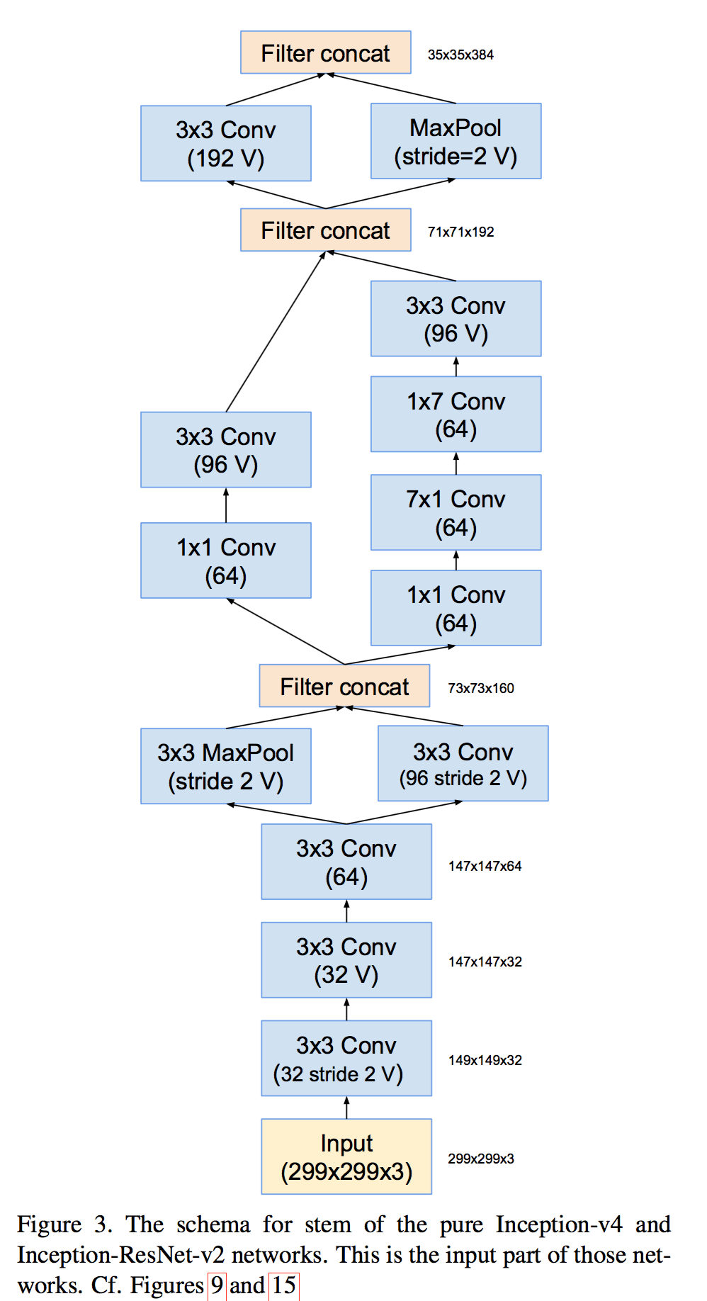
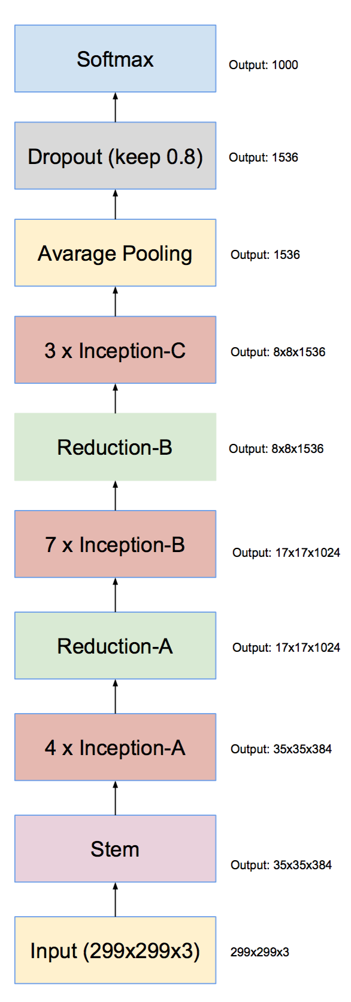
Inception v4

Slide 28
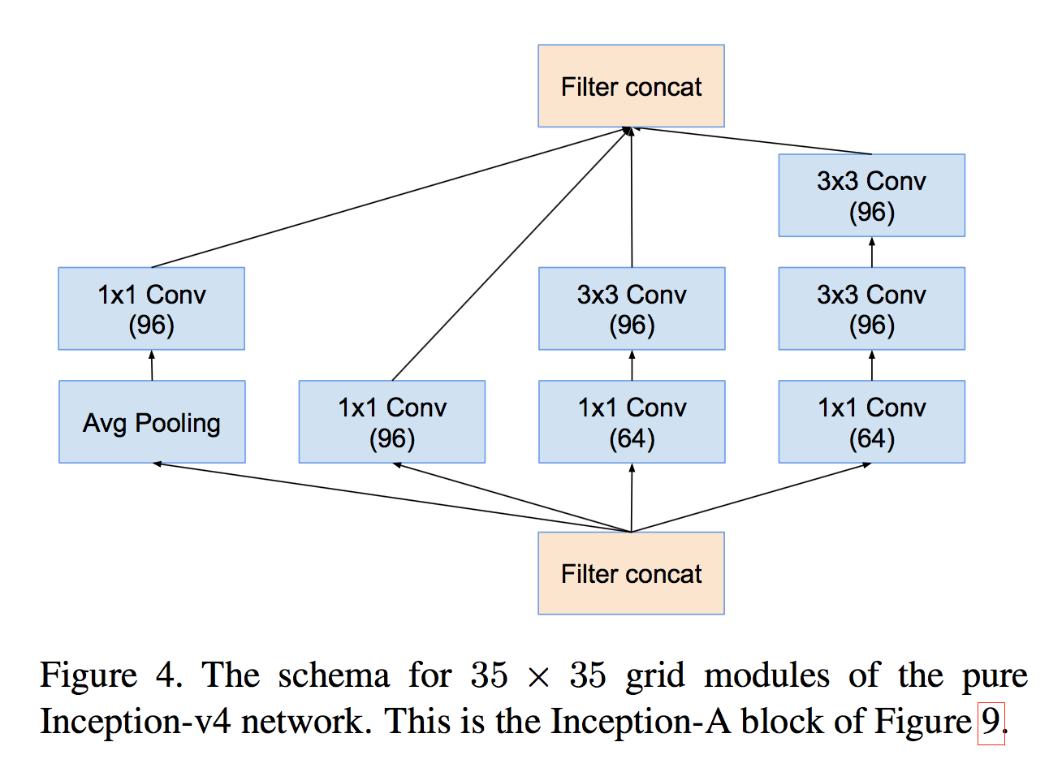
Inception v4

Slide 29
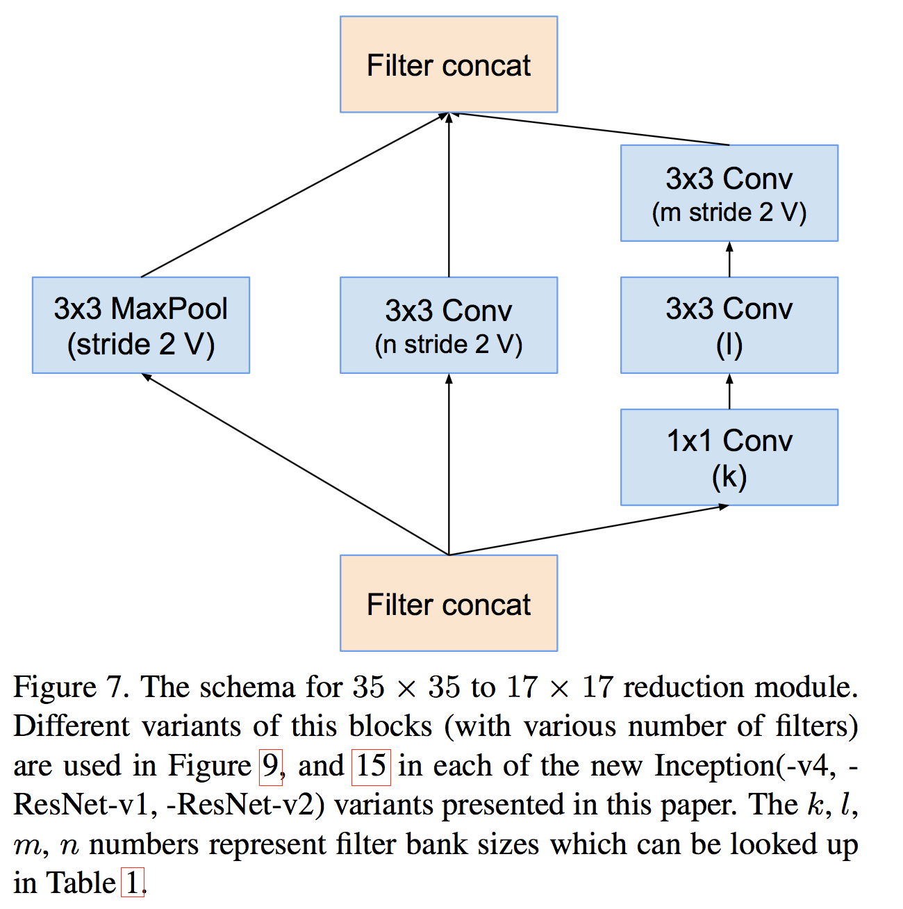
Inception v4

Slide 30
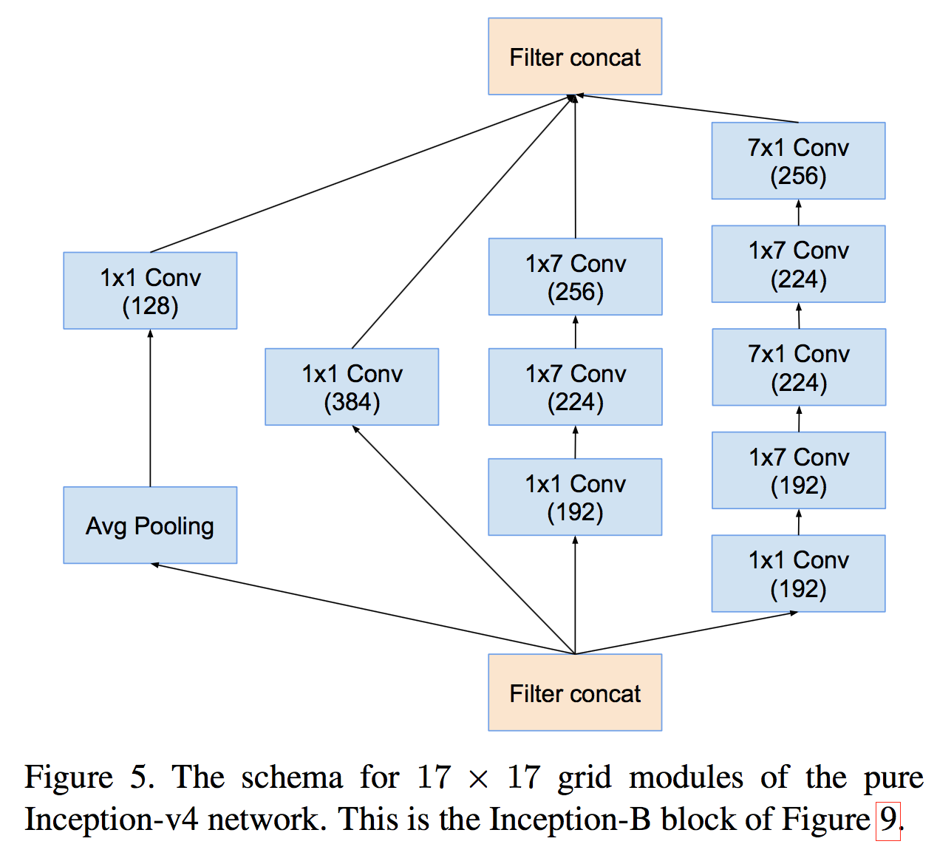
Inception v4

Slide 31
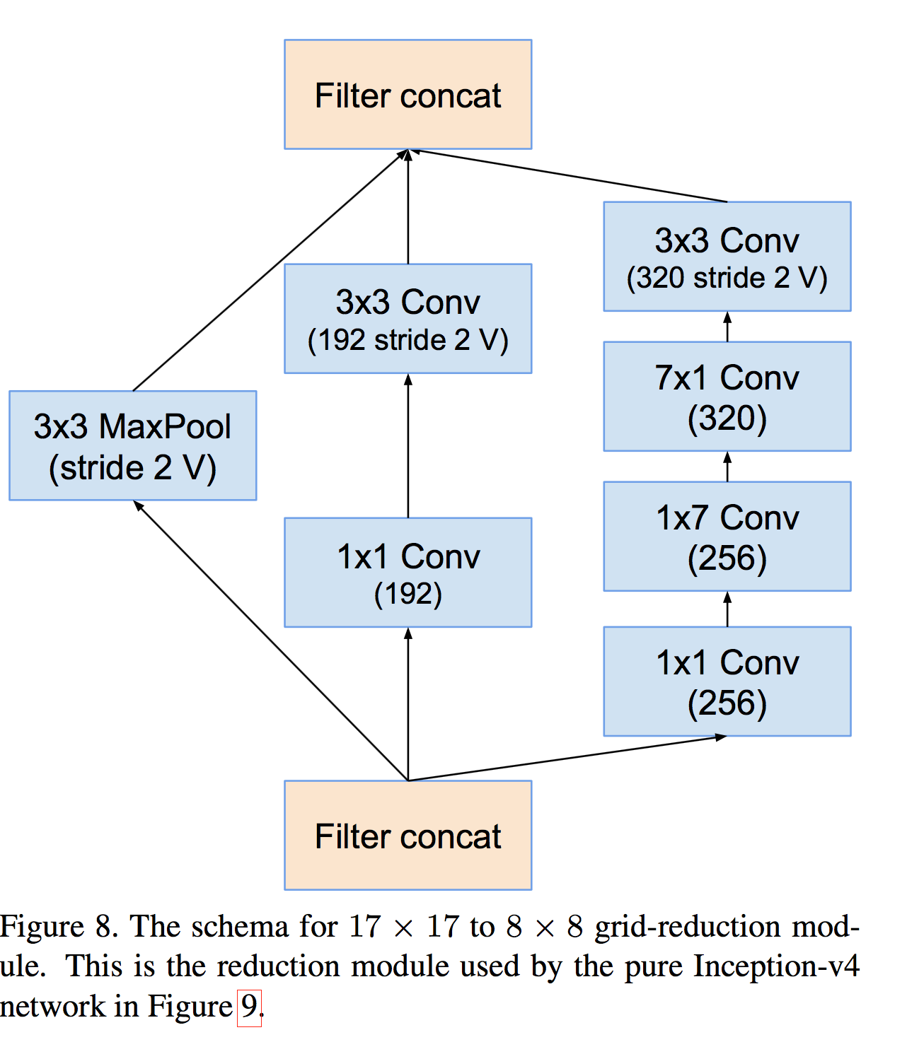
Inception v4

Slide 32
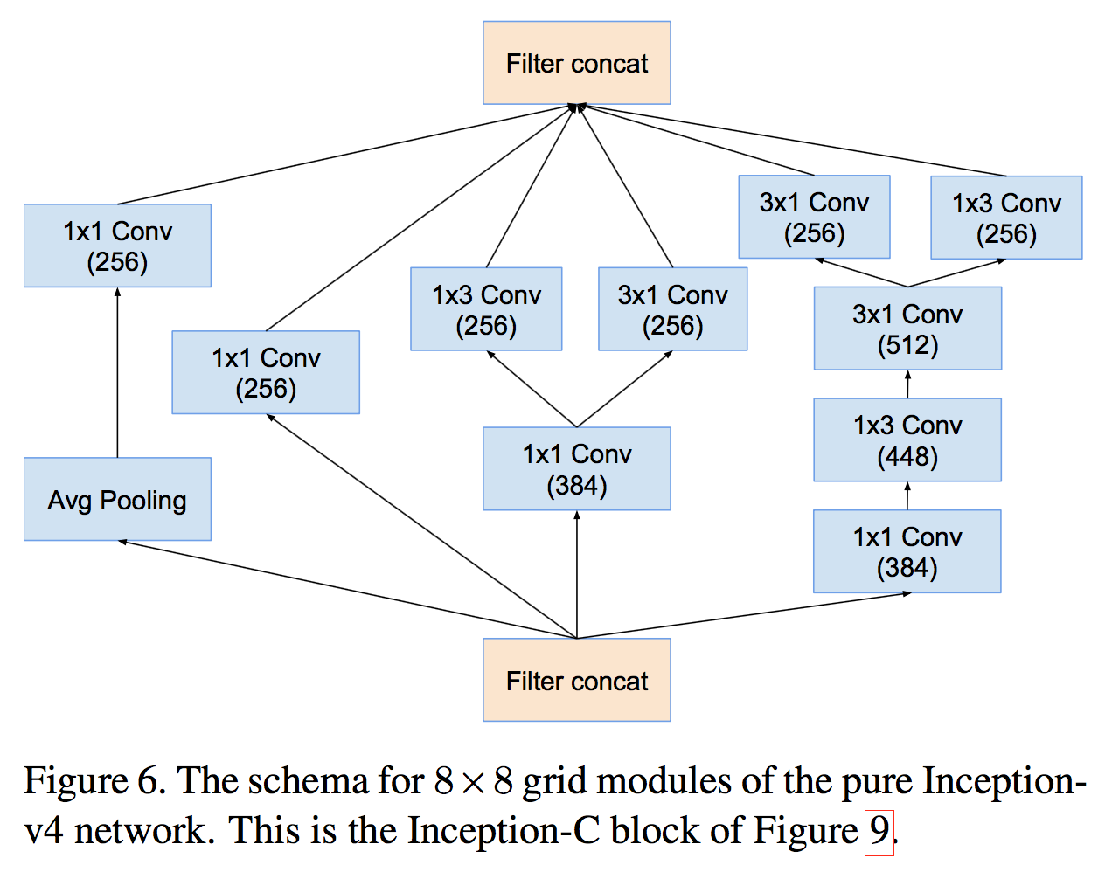
Inception v4

Slide 33
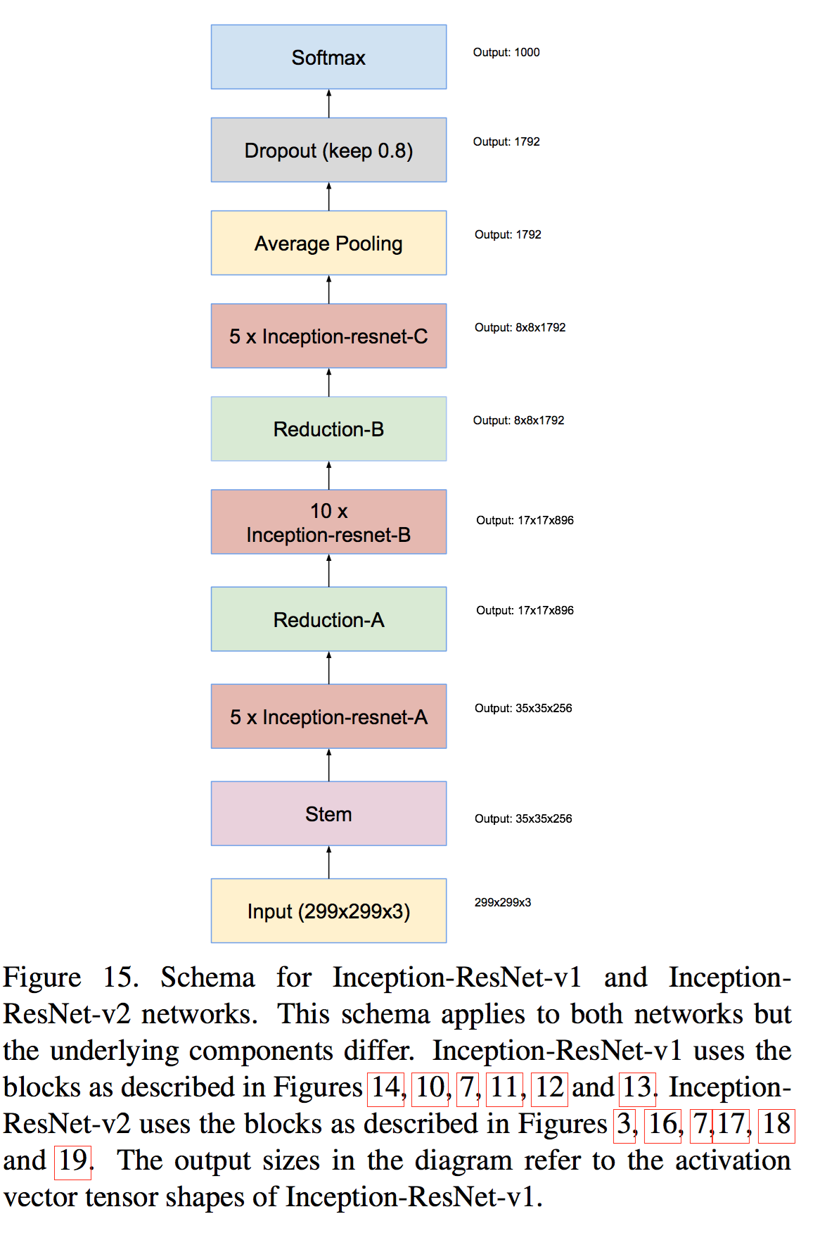
Inception-ResNet-v1

Slide 34
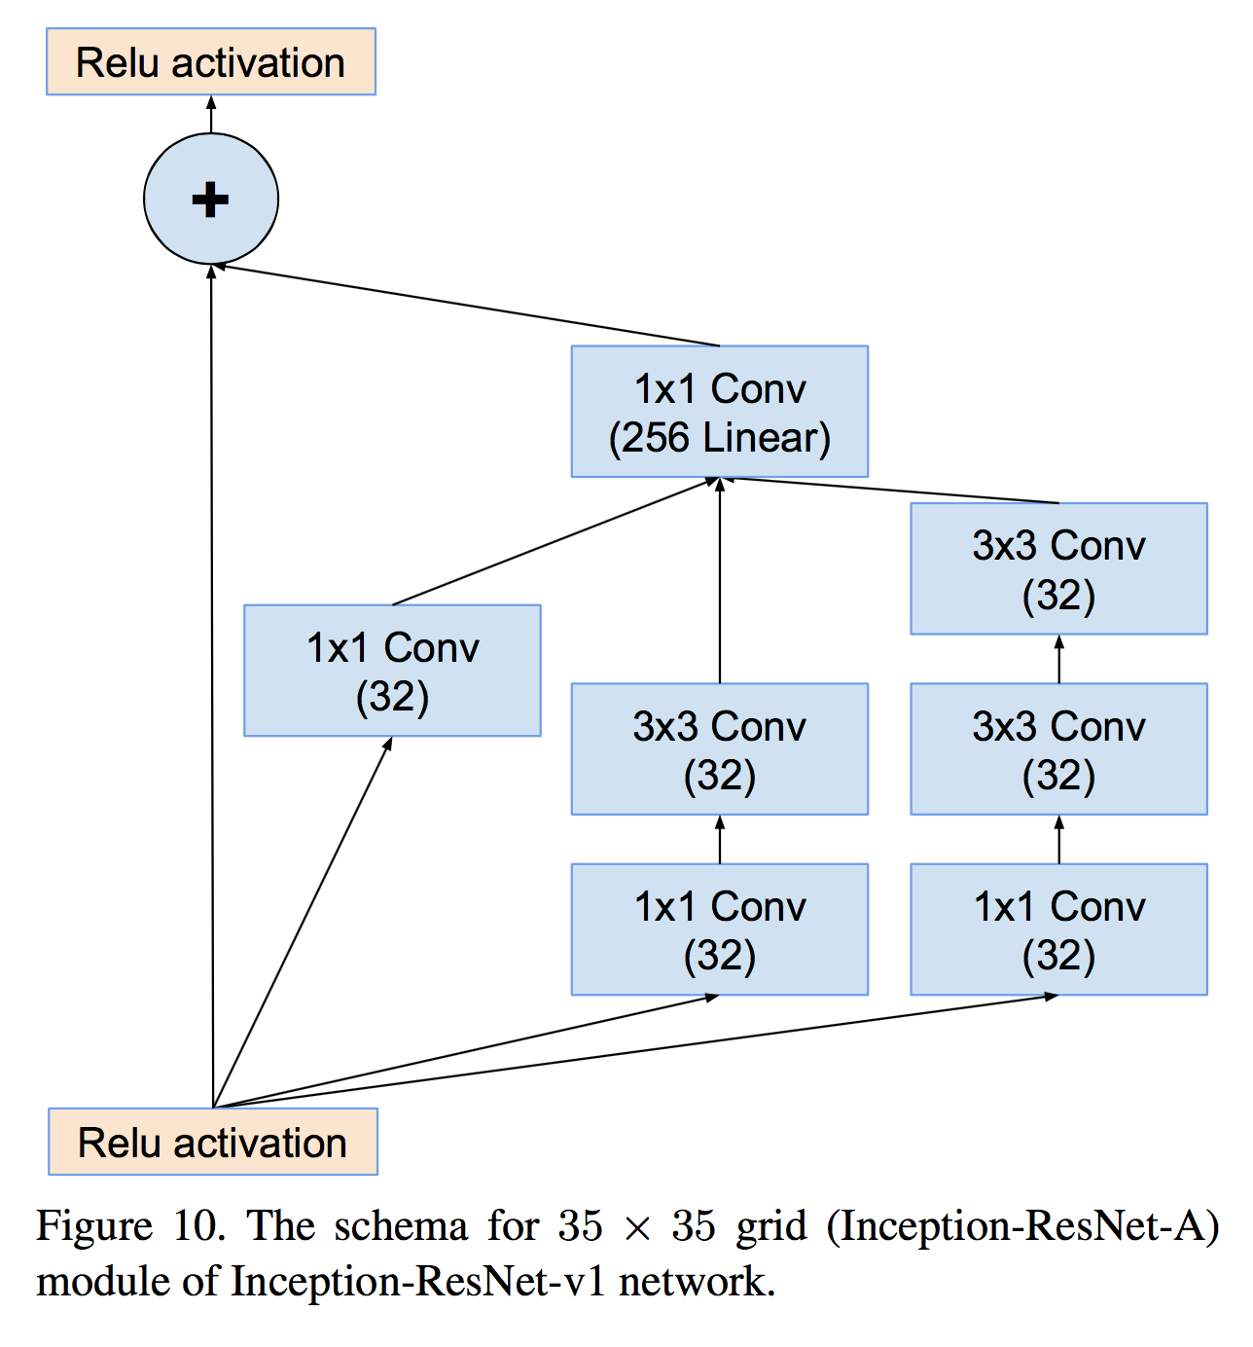
Inception-ResNet-v1

Slide 35
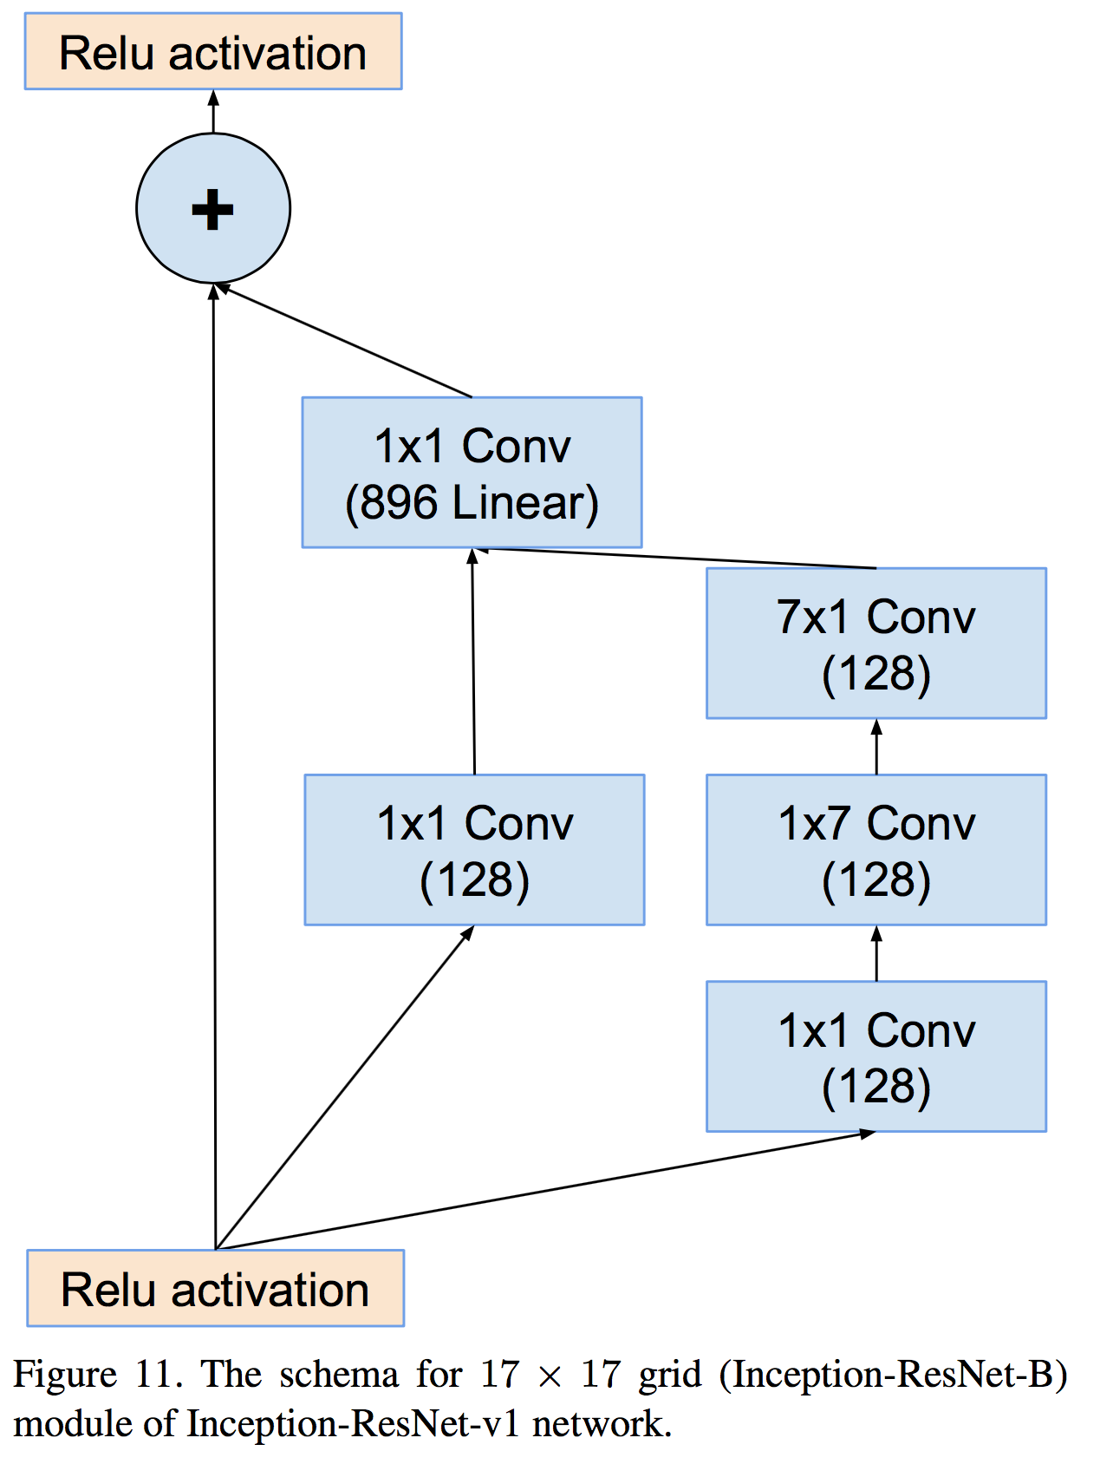
Inception-ResNet-v1

Slide 36
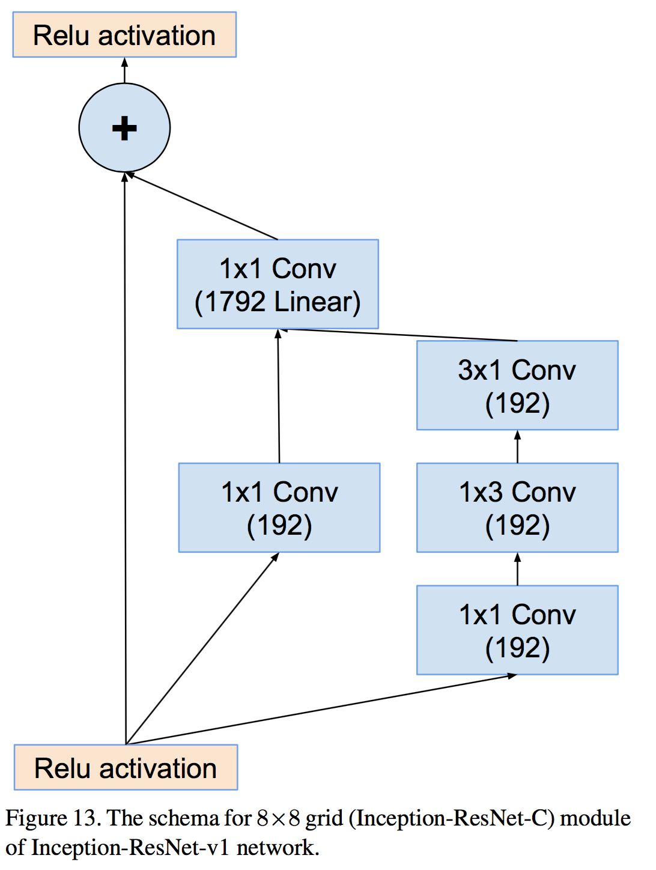
Inception-ResNet-v1

